Slide 1







PISSY BUT PRETTY
EPK
2026

Slide 2

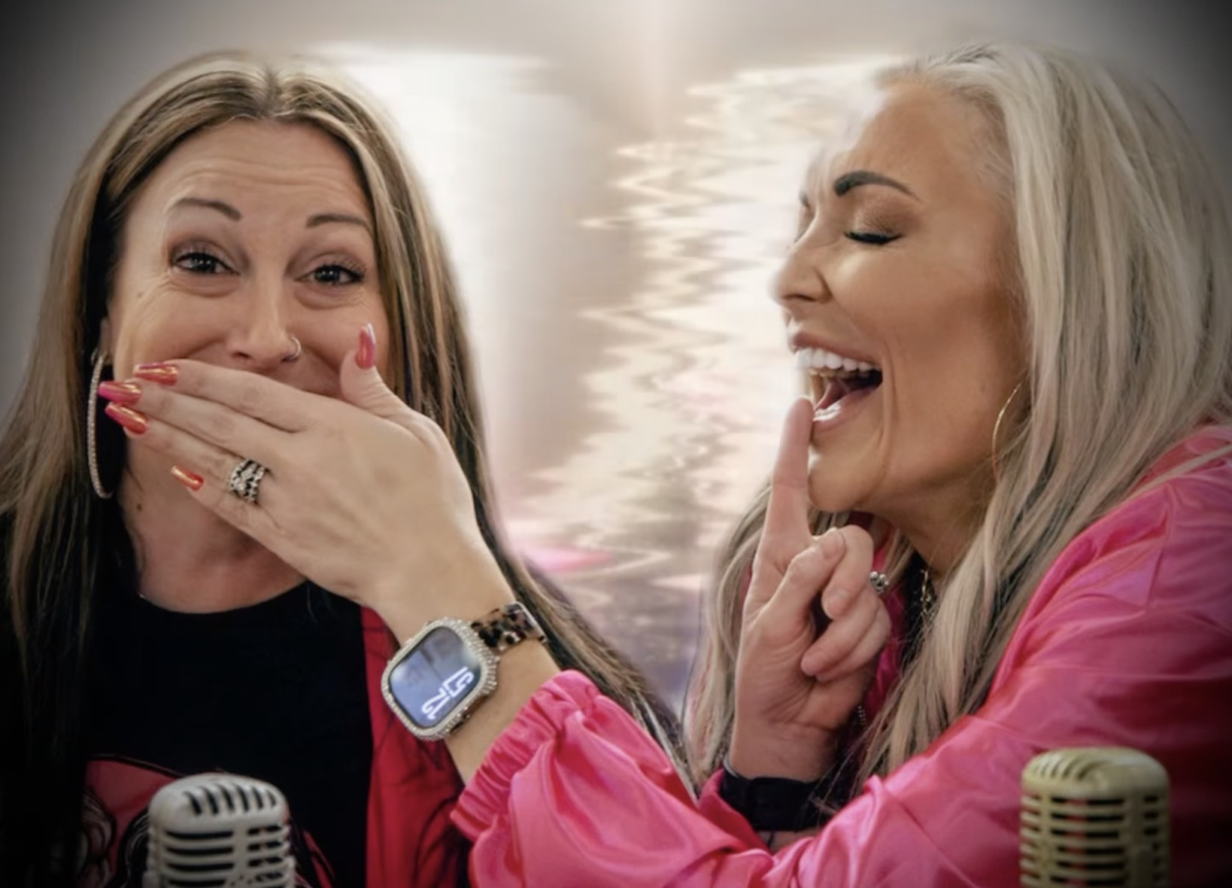
About Pissy But Pretty
“Pissy But Pretty” is an unfiltered podcast about hindsight, healing, humor, and the chaos of becoming yourself, hosted by Heather Karenz and Emily Bagin.
The show blends raw storytelling, dark humor, and hard-earned perspective to create conversations that feel less like “content” and more like sitting at the table with friends who tell the truth.
This is a podcast for people who have lived a little, screwed up a lot, and are still standing.
Listeners don’t come for polish. They come for honesty.
The Sponsorship Opportunity
Sponsorships work on “Pissy But Pretty” because the audience trusts the hosts.
“Pissy But Pretty” is the quintessential Micro-Influencer opportunity for:
Lifestyle & wellness
Mental health & personal development
Beauty, self-care, and apparel
Alcohol-adjacent or adult-skewing lifestyle brands
Host-read and integrated sponsorships feel like recommendations, not ads, and that’s where conversion happens.
If your brand values honesty over hype, and conversions over impressions, this audience is listening.

Slide 3
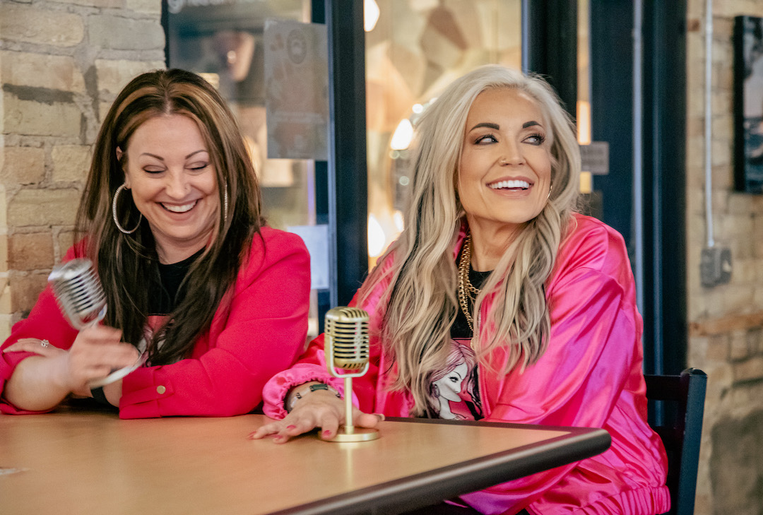
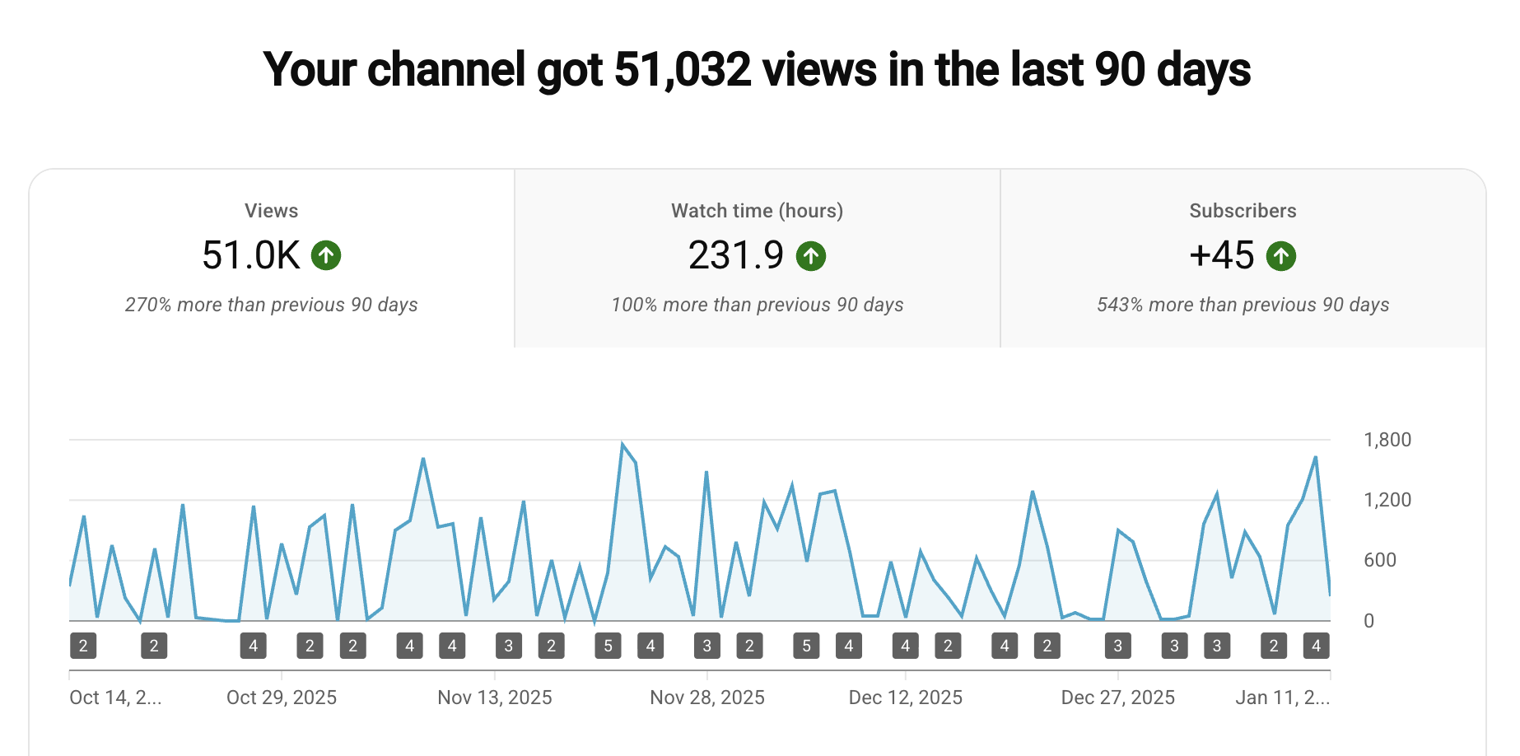
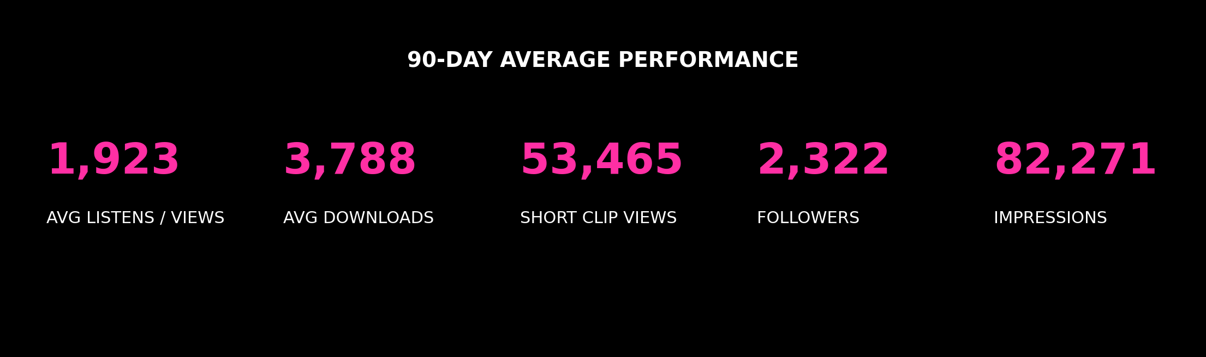
PERFORMANCE & AUDIENCE
90-Day Audience Performance
Why Short-Form Video Matters Here
Pissy But Pretty delivers consistent multi-platform reach across audio, social, and short-form video, creating repeated brand exposure rather than one-off impressions.
These numbers represent active consumption, not vanity reach.
Short-form video is the show’s fastest-growing and widest-reaching format.
Our Short Form Videos create an opportunity for brand messaging, multi-platform reach, and higher top-of-funnel exposure
It’s content that feels native, not interruptive
The Audience
The Pissy But Pretty audience is made up primarily of women 35 - 54 in their prime decision-making years. These listeners value authenticity, personal growth, and trust the thoughts and opinions of the Heather & Emily.
They are:
Highly engaged
Brand-aware
Loyal to voices they trust
Highly responsive to recommendations that feel real

Slide 4
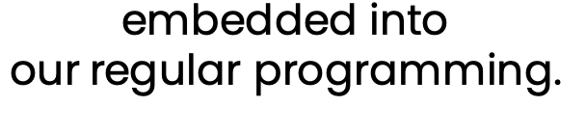
Advertising Packages
Share your message with our audience through custom host-read messages or your own produced content before or embedded into our regular programming.
Ads for each package run for 10,000 downloads & views. 20% discount for three ad buys or more.
SILVER PACKAGE:
GOLD PACKAGE:
PLATINUM PACKAGE:
15-second pre-roll,
30-second mid-roll, and
30-second end-roll ads with call-to-action (CTA) Produced ads: $500
Host Read: $750
30-second pre-roll,
60-second mid-roll, and 30-second end-roll ads with call-to-action (CTA) Produced Ads: $750
Host Read: $1,000
Everything in Gold Package plus all add-ons listed
below
Produced Ads: $1,000
Host Read: $1,500
Host-Read Ads
ADD-ONS:
Banner Ad Across All Digital Platforms: $200 per 20K Impressions
3 Branded Social Video Clips across YouTube and Facebook: $500 for 4 episodes
Contact Info
www.pissybutpretty.com/
hello@pissybutpretty.com

